Slide 1

IPC Chart System
Project
Submitted By:
S. Abhinav (2420090058)
K. Sathvik (2420030685)
P. Phalani (2420030609)
Guide: Dr. Muniraju Naidu Vadlamudi
Associate Professor
KLH University, Hyderabad

Slide 2
Introduction & Problem
IPC data is large and complex
Difficult to analyze manually
No proper visualization tools

Slide 3
Objectives
Visualize IPC data using charts
Identify trends in crime categories
Provide user-friendly interface

Slide 4
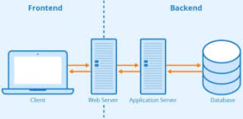
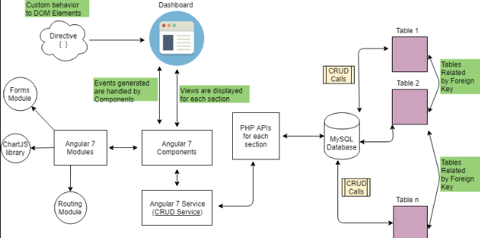
System Architecture
Frontend (UI dashboard)
Backend (logic processing)
Database (IPC records)

Slide 5
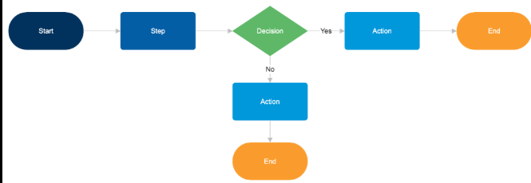
Methodology (Working Flow)
Steps:
Load dataset ‘
Process data
Filter values
Generate charts

Slide 6
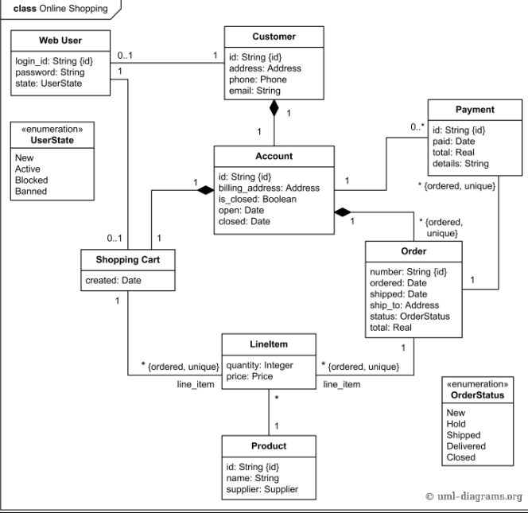
UML / DFD
User interacts with system
Data processed internally
Charts displayed as output

Slide 7
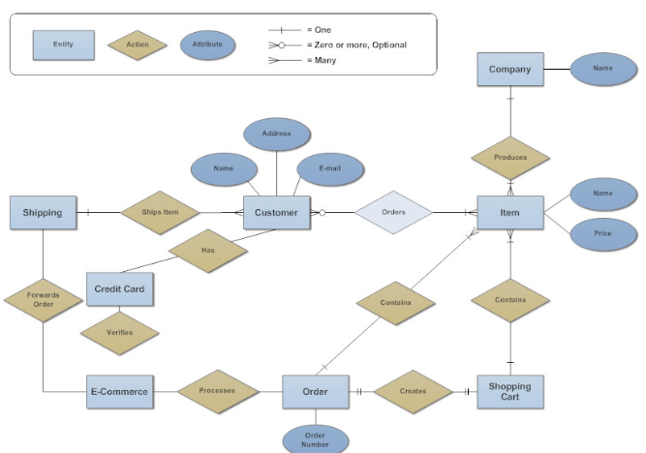
Database Design
Fields:
Crime ID
IPC Section
Category
Year
Location

Slide 8
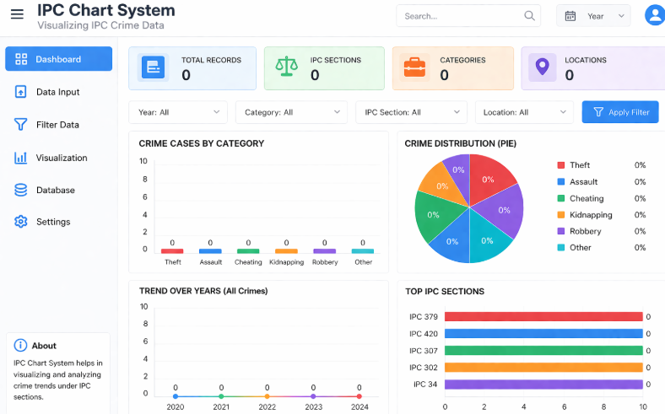
OUTPUT

Slide 9
Conclusion & Future Scope
The system simplifies IPC data analysis
Improves understanding through visualization
Future Enhancements:
AI-based prediction system
Real-time data integration
Mobile application development

